Slide 1
4M Market Coupling
Bucharest, 25/09/2014

Slide 2
Agenda
Czech-Slovak-Hungarian-Romanian Common Parts
Market Coupling Theory and Practice
Where do we come from
Operational overview
Detailed Procedures and Timings with MPs Communication
Decoupling and Fallback Solutions
Member test phase and launch dates
Contacts
Further Information on Romanian Market

Slide 3
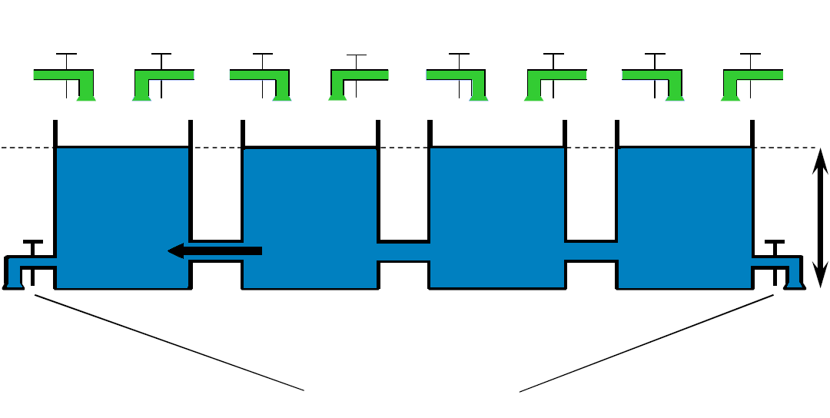
Market Coupling Theory 1/2
Market Coupling (MC) = Implicit Auction: optimal allocation of energy and cross-border transmission capacity rights in one common process. All inputs (bids and capacity data) are taken into account together.
Method: almost the same as local matching of bids but using cross-border profiles as constraint of trade between market areas.
Energy, maximised by cross-border capacity, flows from low price area to high price area in order to try to balance the market prices.
S E L L E R S
High
Price
Area
Low
Price
Area
50Hz
Capacity
Constraint
B U Y E R S

Slide 4
Market Coupling Theory 2/2
In case of price difference between two neighbouring areas, congested border in the direction of the high price area.
In case of equal prices of two neighbouring areas, transmission capacity was enough for the market.
Price difference (spread) between
neighbouring market areas’ prices
=
Capacity auction price
Capacity auction price multiplied by
cross-border flow
=
TSOs’ Congestion Revenue
Implementation of MC requires close TSO-PX cooperation and NRA support.
Operation of MC is daily common process operated by the involved TSOs and PXs.

Slide 5
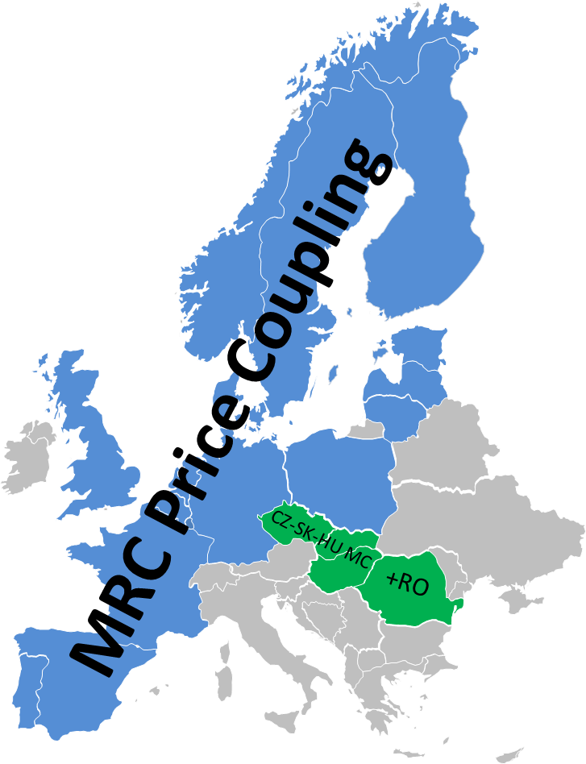
Market Coupling in Practise
Theoretically Proved Optimal
Day-Ahead Trading Form
Several Implementation Project on voluntary basis
Flow-Based MC defined as day-ahead Target Model
Elaboration of harmonized EU legal background
Implementation of European Price Coupling as soon as possible and involving at least all EU Member States

Slide 6
Where do we come from?
30 May 2011 Memorandum of Understanding among CZ, SK, HU Parties
11 Sept 2012 Launch of CZ-SK-HU Market Coupling
Meanwhile Romanian and Polish Letter of Intent on participating
July 2013 Memorandum of Understanding among 5M
(CZ-SK-HU+RO+PL) Parties
August 2013 Decision on starting 4M MC Project with the goal to implement CZ-SK-HU+RO MC; Polish parties in observer status
Tomorrow Launch of
4M Market Coupling
Near Future Further steps towards the
European Price Coupling (Target Model)
via CEE project to join Multi-Regional Coupling
Notes:
OTE

Slide 7
4M Market Coupling Project
Day-ahead ATC based price coupling covering Czech-Slovak-Hungarian+Romanian market areas
Members:
CZ-SK-HU-RO TSOs & PXs & NRAs
Observers: Polish TSO & PX & NRA

Slide 8
Project goals
Main goals:
Extension of CZ-SK-HU MC to Romania
4M countries wish to introduce benefits of market integration to market participants as soon as possible
Get prepared for joining European Price Coupling – implement MC based on PCR solution
Context:
Stepwise market integration is the only way forward due to a blocked situation and slow progress in the CEE region
Flow-based capacity calculation methodology
Overlapping regions and other integration activities
CEE regional solution is not agreed yet
The extension does not hinder the regional development as it is an intermediate step towards European Price Coupling

Slide 9
MC from Market Participants’ point of view
Main characteristics:
Market Participants will be in contact only with those PXs where they are registered members.
In order to participate in 4M MC there is no need to be registered on all PXs, but only on the local one.
Market Participants will use front end trading platform of its local PX for the bid submission and for receiving the results.
After launch of MC, daily explicit capacity auction will be closed down, day-ahead OTC trading on HU-RO border will become impossible. Only long term and intraday cross-border transmission capacity will be available for OTC trade.
When transfer of electricity is requested, MP has to be registered in seller PX and buyer PX.
Notes:
OTE

Slide 10
CZ-SK-HU MC vs. 4M MC
Coupled Romania means bigger liquidity via a new border (HU-RO) involved in more efficient allocation procedure
Implemented PCR solution has no effect on PX-Market Participant communication
No significant change in external procedures and timings
Gate Closure Time remains at 11h00 CET
Minimum price limit moving from -3000 to -500 €/MWh to be follow NWE/MRC benchmark

Slide 11
Agenda
Czech-Slovak-Hungarian-Romanian Common Parts
Market Coupling Theory and Practice
Where do we come from
Operational overview
Detailed Procedures and Timings with MPs Communication
Decoupling and Fallback Solutions
Member test phase and launch dates
Contacts
Further Information on Romanian Market

Slide 12
4M MC topology
CEPS
SEPS
MAVIR
TEL
mTMF
TSO Joint System (mTMF+TSO Cloud)
TSO Cloud
OTE
OKTE
HUPX
OPCOM
EPEX
EPEX
EPEX
4M MC PCR Cloud

Slide 13
PX technical solution
PCR implementation fully in line with the target model
1 Full PCR Member (OTE)
3 Serviced PXs (OKTE, HUPX, OPCOM) by EPEX Spot
In operation OTE and EPEX Spot act as Coordinator in rotation.
PCR solution is an important step forward for further integration:
implemented interfaces can be reused with further extensions
coupling procedures compatible with MRC (except timing)
PCR IT solution same as in MRC
under implementation in CSE (IBWT Project)
already running in MRC

Slide 14
Harmonisation of market characteristics
Parameter | Value*
Time zone | CET
Standard Publication of Capacities | 9:15 (by TSOs) 9:30 (by PXs)
Deadline for modification of capacities | 10:30
Gate Closure Time | 11:00
Standard Publication of Results by PXs** (Publication Time: Tp) | 11:30-40
Standard Publication of Results by TSOs | Tp + 5 minutes
Nomination Deadline | 14:30
Cross-border Flow decimals | One digit (0.1 MW)
Price decimals | Two digits (0.01€/MWh)
Min/Max prices | €/MWh -500/+3000
Second Auction Trigger | €/MWh -150/+500
Volume Tick size | One digit (0.1 MW)
Price Tick size | Two digits (0.01 €/MWh)
* The timings are subject to the procedural tests.
** Without Second Auction. In case of Second Auction or application of any backup/fallback procedure the publication time is postponed.

Slide 15
TSO technical solution
Equal status of all connected TSOs
The only TSO platform (no rotation, simple contract)
Allows easy changing of PX roles (Coordinator/Non-Coordinator) via TSO Cloud interface system being a single point of contact on behalf of TSO systems towards PX side
Excellent experiences on performance and functionalities from CZ-SK-HU MC
mTMF and TSO Cloud systems are easily extendable
Unlimited number of TSOs and PXs
extension of the system with almost no costs

Slide 16
Coordinated ATC Calculation
Introduction / Extension of MC will not change the capacity calculation method.
For a given border both neighbouring TSOs calculates ATC and the lower value is used for Coupling Calculation and is published
Coordinated Capacity Calculation will be done by SEPS for CZ-SK, SK-HU and HU-RO borders as well.
Long term and intraday allocation procedures remain
Notes:
OTE

Slide 17
4M Market Coupling: Role model
Pre-Coupling
Capacity Calculation
Publications
ATCs
Exchange Bid Submission
Coupling
Market Coupling Calculation (PCR)
Net Positions
Market Clearing Prices
Cross Border Flows = Allocated Capacity
Post-Coupling
Clearing and Settlement
Cross Border Shipment
Cross Border Nominations
Settlement of Cross Border Shipment
Congestion Revenue Distribution
(monthly)
Notes:
OTE

Slide 18
Pre-Coupling
CEPS
SEPS
MAVIR
TEL
1
2c
1
2c
1
2c
1
2c
Capacity calculation
mTMF
2a
2d
PUB
TSO Joint System (mTMF+TSO Cloud)
2b
TSO Cloud
Providing capacity data to PX side
2e
2e
2e
2e
2e
2e
2e
Bid collection (and provision to SP)
3a
3a
3a
3a
2f
2f
2f
PUB
PUB
OTE
PUB
2f
OKTE
HUPX
OPCOM
PUB
3b
3b
3b
3b
3c
3c
3c
Data sharing
Service Provider
Service Provider
Service Provider
Data sharing
2g
2g
2g
2g
4M MC PCR Cloud
Note: number of SPs is to be at least 1 and at most 3

Slide 19
Coupling
TSO Joint System (mTMF+TSO Cloud)
7c
7c
TSO Cloud
PUB
mTMF
Results to TSO side
7a
7b
7a
7a
PUB
PUB
7a
PUB
OTE
OKTE
HUPX
OPCOM
PUB
5
5
5
5
5
6
5
6
5
6
Coordinator
Service Provider
Service Provider
Service Provider
Coupling Calculation
5
5
4
3d
5
6
3d
5
6
3d
5
6
3d
5
6
4M MC PCR Cloud
Rotation of Coordinator role will be applied.

Slide 20
Post-Coupling
12
PUB
mTMF
12
Results
9
9
9
9
CEPS
Shipper
10
10
SEPS Shipper
MAVIR Shipper
TEL Shipper
11
10
11
11
10
Shipping
12
12
12
8b
8b
8b
8b
8a
8a
8a
HUPX
8a
OTE
OKTE
OPCOM
Local settlement
8b
8b
8b
8b

Slide 21
Cross-border Shipping
Each TSO acts as Shipper on its local market mediating/transmitting electricity between neighbouring market areas in a centralized way.
Shippers must respect Market Coupling Result: allocated capacity rights = cross-border flows.
Cross-border trade on a given border is settled between neighbouring Shippers on the price of exporting market area (lower price).
Internal trade between Shipper and local market is settled on local market area price.
Importing Shipper receives the Capacity Right, collects the Congestion Revenue and distributes it to the relevant TSOs.

Slide 22
Cross Border Shipping
For example if the energy flows from CZ to SK, and from SK & RO to HU:
Daily Process
CZ Market
SK Market
HU Market
RO Market
Market Coupling
Local Trades,
Clearing & Settlement
CZ Shipper
SK Shipper
HU Shipper
RO Shipper
XB Energy Settlement & Clearing
Monthly Pr.
Congestion Revenue Distribution
CZ TSO
SK TSO
HU TSO
RO TSO
Money Flow;
Energy Flow

Slide 23
Agenda
Czech-Slovak-Hungarian-Romanian Common Parts
Market Coupling Theory and Practice
Where do we come from
Operational overview
Detailed Procedures and Timings with MPs Communication
Decoupling and Fallback Solutions
Member test phase and launch dates
Contacts
Further Information on Romanian Market

Slide 24
Operational Processes and Timing - Overview
10:30-10:35
11:00
11:40
12:35 -12:40
9:30
11:25
13:30
14:30
Coord. Cap. Calc.
Exchange Bids Submission
Normal Business Run
Exceptional Procedures
Early Fallback
Fallback
Nomination
Deadline for Announcement of early decoupling
Deadline for Announcement of decoupling

Slide 25
Normal Process Timing of normal mode
Reception of the ATC
Reception of Orders
MC Calculation
Transfer of the results for PX validation
Validation of the results
Publication of the results
Nomination
Publication of the ATC
Start
Time
9:15
9:25
11:00
11:40
9:25
9:30
11:40
14:30
End
Time
ATC will be published at 9:15 on mTMF homepage (www.sepsas.sk) and on each website of PXs at 9:30
ATC could be modified till 10:30 by mTMF and updated on each website of mTMF and PXs
PX gate closure time at 11:00
Publication of market results at 11:40
Nomination deadline at 14:30

Slide 26
Second Auction Procedure and Timings publications
Due to thresholds detected in CZ, SK, HU, RO prices after MC calculation, all order books are reopened to market parties for 10 minutes and a 2nd calculation is performed.
Due to this second calculation Market Results are delayed around 50 minutes.
Additional Steps
Thresholds detected
+ 50 min
Reception ATC
Reception of Orders
MC Calculation
Transfer of the results for PX validation
Validation of the results
Publication of the results
Nomination
OBK reopen
MC Calculation
Public. ATC
SA prep.
Start
Time
9:15
9:25
11:00
11:50
12:00
12:30
9:25
9:30
~11:35
12:00
12:30
14:30
End
Time
~11:40
PX gate closure time at 11:00 PX gate reopened at 11:50 PX gate closure time at 12:00 Expected publication of results at 12:30 Note: This timing could be changed in specific case
Threshold reached - Reopening of the Order Books

Slide 27
Second Auction Procedure and Timings publications
Timing | Message | Additional Actions for MPs | Market Results Publication | Nomination Deadline
~11:40 | Reopening of the Order Books | OBKs reopen for 10 minutes | 12:30 | 14:30
Example Message for „Reopening of the Order Books”:
Threshold reached - Reopening of the Order Books
2nd auction for delivery day 05.12.2014 has been called:
Opening of 2nd auction session: 11:50
Closing of 2nd auction session: 12:00
The results are expected around: 12:30
Note that you can also bid on market areas that are not concerned and that the order book will reopened for buy and sell bids.
Market SK:
Upper threshold exceeded for hours 19, 20, 21 - Seller required
Lower threshold exceeded for hours 22, 23, 24 - Buyer required
Please note that all bids already received before will also be included the Second Auction calculation provided that they will not be changed/deleted during the reopening of the order books now.
Please be aware that the second auction procedure follows the local market rules.

Slide 28
Coupling Process delayed Slight delay
Due to technical problems in the coupling process, the process remains the same but actions are delayed in time (for example 20 minutes)
Technical
problem
+ 20 min
Reception of the ATC
Reception of Orders
MC Calculation
Transfer of the results for PX validation
Validation of the results
Publication of the results
Nomination
Publication of the ATC
Start
Time
9:15
9:25
11:00
12:00
9:25
9:30
~11:10
12:00
14:30
End
Time
11:40
Delay in Market Coupling Results publication

Slide 29
Coupling Process delayed Slight delay
Timing | Message | Additional Actions for MPs | Market Results Publication | Nomination Deadline
11:40 | Delay in Market Coupling Results publication |  | 12:00 | 14:30
Example Message for „Delay in Market Coupling Results publication“:
Delay in Market Coupling Results publication
The Market Coupling process is delayed due to technical reasons or market issues.
Therefore, the publication of the Market Coupling Results is delayed.
We will keep you informed as soon as new information is available.

Slide 30
Coupling Process delayed Critical delay (scenario with an avoided decoupling just in time)
Due to technical problems in the coupling process, the process remains the same but actions are delayed in time (maximum delay before decoupling is 55 minutes)
Technical
problem
+ 55 min
Reception of the ATC
Reception of Orders
MC Calculation
Transfer of the results for PX validation
Validation of the results
Publication of the results
Nomination
Publication of the ATC
Start
Time
9:15
9:25
11:00
12:35
9:25
9:30
~11:10
12:35
14:30
End
Time
11:40
12:05
Delay in Market Coupling Results publication
Risk of Decoupling and
Shadow Auction
Update bids in fallback explicit capacity auction systems

Slide 31
Coupling Process delayed Critical delay (scenario with an avoided decoupling just in time)
Timing | Message | Additional Actions for MPs | Market Results Publication | Nomination Deadline
11:40 | Delay in Market Coupling Results publication |  |  | 14:30
12:05 | Risk of Decoupling and Shadow Auction | Bids update in Shadow Auction systems | 12:35 | 14:30

Slide 32
Coupling Process delayed Critical delay (scenario with an avoided decoupling just in time)
Example Message for „Risk of Decoupling and Shadow Auction“:
Risk of Decoupling and Shadow Auction
Please be aware that the calculation of the CZ-SK-HU-RO market results is severely further delayed due to ongoing technical reasons or market issues.
In case of decoupling another message will be sent shortly after 12:35 to announce the decoupling.
Please be aware that in case of decoupling becomes necessary, order books will be reopened at short notice for 20 minutes after the announcement of decoupling and for all four markets local calculations will be run separately by HUPX, OKTE, OTE and OPCOM. Please be prepared in case you intend to modify your bids in case decoupling occurs.
In case of CZ-SK-HU-RO decoupling ATCs for SK-HU border, CZ-SK border and HU-RO border will be allocated explicitly via Shadow Auction. Please be aware that the Shadow Auction gate will close at 12:35 to run in parallel.
If CZ-SK-HU-RO is decoupled Shadow Auction results will be published as soon as possible but at the latest at 12:45.
Therefore, we strongly advise you to update your shadow bids at MAVIR KAPAR system for SK-HU border and HU-RO border and/or ČEPS DAMAS platform for CZ-SK border before the Gate Closure of the Explicit shadow auction at 12:35.

Slide 33
ATC Modification PX gate closure time unimpacted
+ 0 min
Reception of ATC
MC Calculation
Transfer of the results for PX validation
Validation of the results
Publication of the results
Nomination
Publication of ATC
Reception of Orders
Possibility of ATC modification
Start
Time
9:15
9:25
9:30
11:00
11:40
9:25
9:30
10:30
11:40
14:30
End
Time
9:30-10:30
ATC CYCLE Reception of ATC: 9:15 – 9:25 Publication of ATC on PXs: 9:30 Possibility of ATC modification: 9:30 – 10:30 PX gate closure time at 11:00
Update of ATC values

Slide 34
ATC Modification PX gate closure time unimpacted
Timing | Message | Additional Actions for MPs | ATC Publication | PX Gate Closure
9:30 - 10:30 | Update of ATC values | Exchange bids update (based on the updated ATC values) | As soon as ATC are published, but at the latest at 10:30 | 11:00
Example Message for „Update of ATC values“:
Update of ATC values
Please note the ATC values were modified.

Slide 35
ATC Process delayed Slight delay
Due to technical problems in the ATC cycle, the process remains the same but actions are delayed in time (for example 10 minutes)
Technical
problem
+ 0 min
Reception of the ATC
Reception of Orders
MC Calculation
Transfer of the results for PX validation
Validation of the results
Publication of the results
Nomination
Start
Time
9:15
11:00
11:40
9:20
9:40
11:40
14:30
End
Time
~09:30
9:40
Delay in ATC values publication
ATC Delay
Delay in ATC values publication
ATC are published

Slide 36
ATC Process delayed Slight delay
Timing | Message | Additional actions for MPs | ATC Publication | PX gate closure
~ 9:30 | Delay in ATC values publication: ATC Delay |  | As soon as ATC are published, but at the latest at 10:30 | 11:00
9:40 | Delay in ATC values publication: ATC are published | Exchange bids update (based on the updated ATC values) | As soon as ATC are published, but at the latest at 10:30 | 11:00
Example Message for „Delay in ATC values publication“:
Delay in ATC values publication
The publication of the ATC values of the 4M MC region is delayed due to technical reasons. We will inform you as soon as the ATC values are published.
or (depending on the step)
Please note that ATC values are published now.

Slide 37
ATC Process delayed Critical delay - PX gate closure time unimpacted
Due to technical problems in the ATC cycle, the process remains the same but actions are delayed in time (maximum delay before early decoupling is 60 min)
Technical
problem
+ 0 min
Reception of the ATC
Reception of Orders
MC Calculation
Transfer of the results for PX validation
Validation of the results
Publication of the results
Nomination
Start
Time
9:15
11:00
11:40
9:20
10:30
11:40
14:30
End
Time
~09:30
10:00
10:30
Delay in ATC values publication
ATC Delay
Risk of Early Decoupling and Shadow Auction
Delay in ATC values publication
ATC are published
Update bids in fallback explicit capacity auction system

Slide 38
ATC Process delayed Critical delay - PX gate closure time unimpacted
Timing | Message | Additional actions for MPs | ATC Publication | PX gate closure
~ 9:30 | Delay in ATC values publication: ATC Delay |  | As soon as ATC are published, but at the latest at 10:30 | 11:00
10:00 | Risk of Early Decoupling and Shadow Auction | Shadow Auction bids update | As soon as ATC are published, but at the latest at 10:30 | 11:00
10:30 | Delay in ATC values publication: ATC are published | Exchange bids update (based on the published ATC values) | At the latest at 10:30 | 11:00

Slide 39
ATC Process delayed Critical delay - PX gate closure time unimpacted
Example Message „Risk of Early Decoupling and Shadow Auction”:
Risk of Early Decoupling and Shadow Auction
The Market Coupling process encounters a risk of Early Decoupling due to ongoing technical reasons or market issues.
In case problems cannot be solved and decoupling becomes necessary another message will be sent shortly after 10:30 to announce the decoupling.
Please be aware that in case of decoupling becomes necessary, order books will close as usual at 11:00 and for all four markets local calculations will be run separately by HUPX, OKTE, OTE and OPCOM. Please be prepared in case you intend to modify your bids in case decoupling occurs.
In case of CZ-SK-HU-RO decoupling ATCs for SK-HU border, CZ-SK border and HU-RO border will be allocated explicitly via Shadow Auction. Please be aware that the Shadow Auction gate will close at 10:30 to run in parallel. Shadow Auction results will be published at 10:40 but only if CZ-SK-HU-RO is decoupled.
Therefore, we strongly advise you to update your shadow bids before 10:30 at ČEPS DAMAS platform for CZ-SK border and/or MAVIR KAPAR system for SK-HU border and HU-RO border .

Slide 40
Agenda
Czech-Slovak-Hungarian-Romanian Common Parts
Market Coupling Theory and Practice
Where do we come from
Operational overview
Detailed Procedures and Timings with MPs Communication
Decoupling and Fallback Solutions
Member test phase and launch dates
Contacts
Further Information on Romanian Market

Slide 41
Decoupling and Fallback Solutions
Decoupling
Due to a technical problem in market coupling process, no market results can be provided till the critical deadline and Fallback solutions shall be applied.
Czech Market
CZ - SK Border
Slovak Market
SK - HU Border
Hungarian Market
HU - RO Border
Romanian Market
Normal
CZECH-SLOVAK-HUNGARIAN-ROMANIAN MARKET COUPLING
Day-ahead
Fallback
CZECH LOCAL DAY AUCTION
EXPLICIT SHADOW AUCTION
SLOVAK LOCAL DAY AUCTION
EXPLICIT SHADOW AUCTION
HUNGARIAN LOCAL DAY AUCTION
EXPLICIT SHADOW AUCTION
ROMANIAN LOCAL DAY AUCTION
No partial decoupling will be applied

Slide 42
Decoupling and Fallback Solutions
Decoupling in CZ-SK-HU-RO MC could be announced in two cases:
1) is not possible, for a specific day, to allocate the available transmission capacity via the normal daily implicit allocation, i.e.: a critical deadline in the time schedule is reached and no solution is found before the critical deadline to publish the market results. This type of decoupling is called “Full Decoupling”.
Critical deadline for announcing decoupling is 12:35.
2) is not possible, for a specific day, to fix severe problems in TSO Management Function system and/or ATC calculation/provision process. In this case decoupling is announced early, i.e. far before PXs order book gate closure. This special type of decoupling is called “Early Decoupling”. The default timing of “Early Decoupling” aims at keeping the normal PXs order book gate closure time unchanged (11h00).
Critical deadline for announcing early decoupling is 10:30.

Slide 43
Shadow auction – general fallback for 4M MC capacity allocation
ČEPS and MAVIR are shadow auction organizers in CZ-SK-HU-RO MC
ČEPS for CZ – SK border;
MAVIR for SK – HU & HU – RO borders
Main characteristics:
Shadow bids can be submitted for 30 consecutive days in advance;
If decoupling is not announced, bids are not evaluated, no explicit allocation of capacity;
By the time of announcing decoupling and switch to fallback, the bids are evaluated;
After the publication of cross-border explicit auction results PX Order Books are still open for 20 min to update PX bids;
There will not be any change in nomination process.

Slide 44
Contacts to shadow auction organizers
ČEPS
Operators | +420 211 044 507 | helpdesk.trade@ceps.cz
 | +420 724 601 301
MAVIR
Operators | +36 1 304 1449 | auctionoffice@mavir.hu

Slide 45
Decoupling Fall-back mode
Gate Opening of Shadow Auction
on CZ-SK, SK-HU and HU-RO border
Publication of
Results of
Shadow Auction
Start
Time
nomination deadline
at 14:30
09:15
12:35
End
Time
12:35
12:45
Technical
problem
CZ SK HU RO Decoupling
Publication
ATC
Gate Closure
of OBK
CZ-SK-HU-RO Coupling Process
OBKs
reopen
Local calculation by
OTE, OKTE, HUPX and OPCOM
(with the possibility of 2nd auction)
Nomination
Start
Time
11:00
12:35
13:05
13:30 – 13:45
13:30 – 13:45
09:30
~ 11:15
12:35
13:05
14:30
End
Time
11:40
12:05
12:35 – 12:40
Delay in Market Coupling Results publication
Risk of
Decoupling and
ShadowAuction
Full Decoupling
and Shadow
Auction
Update bids in fallback explicit capacity auction system

Slide 46
Decoupling Fall-back mode
Timing | Message | Additional actions for MPs | Market results Publication | Nomination deadline
11:40 | Delay in Market Coupling Results publication |  |  | 14:30
12:05 | Risk of Decoupling and Shadow Auction | Bids update in Shadow Auction system |  | 14:30
12:35- 12:40 | Full Decoupling and Shadow Auction | Bids update in trading system of PXs | 13:30 – 13:45 (or sooner, if results are available) | 14:30

Slide 47
Decoupling Fall-back mode
Example Message „Full Decoupling and Shadow Auction”:
Full Decoupling and Shadow Auction
Due to technical problems, the CZ-SK-HU-RO Market Coupling cannot be run for delivery date: DD.MM.YYYY
CZ, SK, HU and RO are decoupled. Local calculations will be run separately by HUPX, OKTE, OTE and OPCOM for the four markets.
As a consequence of the CZ-SK-HU-RO decoupling, the CZ-SK-HU-RO order books will be reopen as soon as technically possible (latest 12:45) and finally close at 13:05. For more information please follow the local auction rules of each PX.
ATCs for SK-HU border, CZ-SK border and HU-RO border will be allocated explicitly via Shadow Auction. Please refer to MAVIR (KAPAR system) the website of MAVIR for SK-HU border and HU-RO border and/or ČEPS (DAMAS Platform) for CZ-SK border to get the results of the Shadow Auction, which are available as soon as possible (latest at 12:45).

Slide 48
Early Decoupling Fall-back mode
Gate Opening of Shadow Auction
on CZ-SK, SK-HU and HU-RO border
Publication of
Results of
Shadow Auction
Start
Time
nomination deadline
at 14:30
09:15
10:30
End
Time
10:30
10:40
Technical
problem
CZ SK HU RO Decoupling
ATC Reception & publication
OBKs
open
Local calculation by
OTE, OKTE, HUPX and OPCOM
(with the possibility of 2nd auction)
Nomination
Start
Time
09:15
10:30
11:00
11:25 – 11:40
~ 9:20
11:25 – 11:40
10:30
11:00
14:30
End
Time
~ 9:30
10:00
10:30-10:35
Risk of Early Decoupling and Shadow Auction
Early Decoupling and Shadow Auction
Delay in ATC
values
publication
ATC Delay
Update bids in fallback explicit capacity auction system

Slide 49
Early Decoupling Fall-back mode
Timing | Message | Additional actions for MPs | Market results Publication | Nomination Deadline
~ 9:30 | Delay in ATC values publication: ATC Delay |  |  | 14:30
10:00 | Risk of Early Decoupling and Shadow Auction | Bids update in Shadow Auction system |  | 14:30
10:30 – 10:35 | Early Decoupling and Shadow Auction | Bids update in trading system of PXs | 11:25 – 11:40 (or sooner, if results are available) | 14:30

Slide 50
Early Decoupling Fall-back mode
Example Message „Early Decoupling and Shadow Auction”:
Early Decoupling and Shadow Auction
Due to severe issues in market coupling/ATC cycle process, the entire price coupled area CZ-SK-HU-RO MC will remain fully decoupled for delivery day DD.MM.YYYY.
Local calculations will be run separately by OTE, OKTE, HUPX and OPCOM for the four markets.
Please be aware that order books of OTE, OKTE, HUPX and OPCOM will close as usual at 11:00. For more information please follow the local auction rules of each PX.
ATCs for CZ-SK border, SK-HU border and HU-RO border will be allocated explicitly via Shadow Auction. Please refer to ČEPS (DAMAS platform) for CZ-SK border and/or MAVIR (KAPAR system) for SK-HU border and HU-RO border to get the results of the Shadow Auction which are available as soon as possible (latest at 10:40).

Slide 51
Communication before Fall-back
09:30
09:30 -10:30
11:35 –
11:40
12:05
10:35
(at the latest)
12:40
(at the latest)
11:40
10:00
Time of notification
Delay in ATC
values
publication
ATC delay
Updates of ATC values
Threshold reached - Reopening of the Order Books
Delay in Market Coupling Results publication
Risk of Early Decoupling and Shadow Auction
Risk of Decoupling and
Shadow Auction
Early Decoupling and Shadow Auction
Full Decoupling
and Shadow
Auction

Slide 52
Legend
Start time of one step
End time of one step
End time of one publishing step (ATC or final results)
End time of the delayed step
Counting of the delay for a publishing step
(red = delayed, green = undelayed)
Time of the communication
Object of the communication
Full CZ-SK-HU-RO decoupling
Defective step

Slide 53
Agenda
Czech-Slovak-Hungarian-Romanian Common Parts
Market Coupling Theory and Practice
Where do we come from
Operational overview
Detailed Procedures and Timings with MPs Communication
Decoupling and Fallback Solutions
Member test phase and launch dates
Contacts
Further Information on Romanian Market

Slide 54
Member test phase and launch date
The internal integration test is ongoing currently.
After the internal integration test shall be successfully finished the full integration test together the PXs’ Members will be conducted.
The test period planned to be between 13/10/2014-24/10/2014
The exact timing of the Member test will be distributed shortly before the start of the member test phase.
Members could participate through only those PXs where they are registered members.
Acceptance Tests shortly before go live.
The Launching Date is planned to be 11 November 2014 subject to successfully performed Member&Acceptance tests and final regulatory approval.

Slide 55
Contacts
Company | Role | Contact person | E-mail
OTE | CZ PX | Ondrej Maca | 4M-MC@ote-cr.cz
OKTE | SK PX | Juraj Sedivy | okte@okte.sk
HUPX | HU PX | Dóra Mizsik | mizsik@hupx.hu
OPCOM | RO PX | Cristina Setran | cristina.setran@opcom.ro
CEPS | CZ TSO | Martin Palkovsky | palkovsky@ceps.cz
SEPS | SK TSO | Mario Turcik | mario.turcik@sepsas.sk
MAVIR | HU TSO | Réka Sárközi | sarkozir@mavir.hu
Transelectrica | RO TSO | Mircea Anton | mircea.anton@transelectrica.ro
ERU | CZ NRA | Pavel Círek | eru@eru.cz
URSO | SK NRA | Nataša Hudcovičová | hudcovicova@urso.gov.sk
MEKH | HU NRA | Bakonyi Attila | bakonyia@mekh.hu
ANRE | RO NRA | Lusine Caracasian | lcaracasian@anre.ro

Slide 56
Agenda
Czech-Slovak-Hungarian-Romanian Common Parts
Market Coupling Theory and Practice
Where do we come from
Operational overview
Detailed Procedures and Timings with MPs Communication
Decoupling and Fallback Solutions
Member test phase and launch dates
Contacts
Further Information on Romanian Market

